Slide 1



A little bit about me and the session
Gavin Clark
Business Intelligence Manager, TCS Ireland
I “dabble” in Power BI, unfortunately I don’t get a lot of time to spend developing reports.
Our team looks after the administration and governance of a relatively large Power BI implementation for a US financial services client of TCS
@gavinclark66
https://www.linkedin.com/in/gavinclarkbi/
In today’s session we’re going to talk about Row Level Security (RLS) in Power BI and working through some different patterns that you may find useful.
We’ll also talk about important things to remember about RLS, especially when creating dynamic models

Slide 2





Quick recap on Row Level Security (RLS) Configuration
Power BI Desktop
Power BI Service
Belong To
Ireland Sales
Role(s)
Dataset
Role(s)
Country
Assigned To
Table Name(s)
Country[CountryCode] = “IE”
Report Users
Column Filter(s)

Slide 3
10 Things about RLS to remember !
What you want to filter on must exist in the data
A good data model is essential for Row Level Security
Filter on Dimension Tables always **
Keep it simple where possible
Remember that RLS will affect measures
RLS is applied to the dataset not the report
If you have edit access to the dataset RLS will NOT be enforced
RLS works best in Import mode, care needs to be taken with DQ. RLS not available for LiveConnect
Not all DAX functions are RLS friendly
Test, Test and then Test some more (Desktop and Service)
** where possible, if not, review your data model

Slide 4
Our RLS adventure today - How do we solve for this ?
As a Sales VP,
I want a sales report,
So that my sales team can view their sales revenues
Sales VP
Sales Director #1
Sales Director #2
Sales Manager #1
Sales Manager #2
Sales Manager #3
Sales Manager #4
Sales Person #1
Sales Person #2
Sales Person #3
Sales Person #4
Sales Person #5
Sales Person #6
Sales Person #7
Sales Person #8
Sales Person …

Slide 5
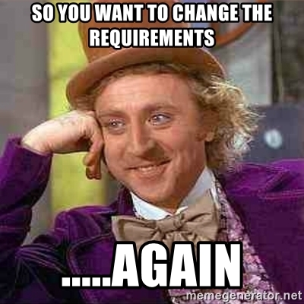
Our RLS adventure today – Requirements change ….. #01
As a Sales VP,
I want to change my sales report,
So that my sales team can view their sales revenues, but only relevant to them
Sales VP
Sales Director #1
Sales Director #2
Sales Manager #1
Sales Manager #2
Sales Manager #3
Sales Manager #4
Sales Person #1
Sales Person #2
Sales Person #3
Sales Person #4
Sales Person #5
Sales Person #6
Sales Person #7
Sales Person #8
Sales Person …

Slide 6
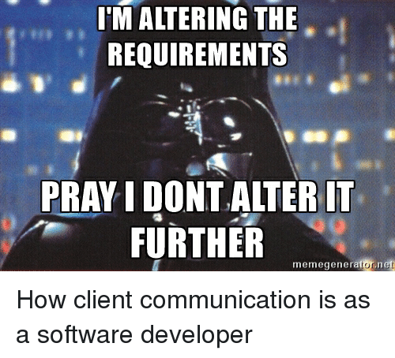
Our RLS adventure today – Requirements change ….. #02
As a Sales VP,
I want to change my sales report,
So that I can share with others to view (and they can see all data)
but my sales team will still only see data relevant to them
“Others”
“Sales Team”
Sales VP
Sales Director #1
Sales Director #2
Sales Manager #1
Sales Manager #2
Sales Manager #3
Sales Manager #4
Sales Person #1
Sales Person #2
Sales Person #3
Sales Person #4
Sales Person #5
Sales Person #6
Sales Person #7
Sales Person #8
Sales Person …

Slide 7
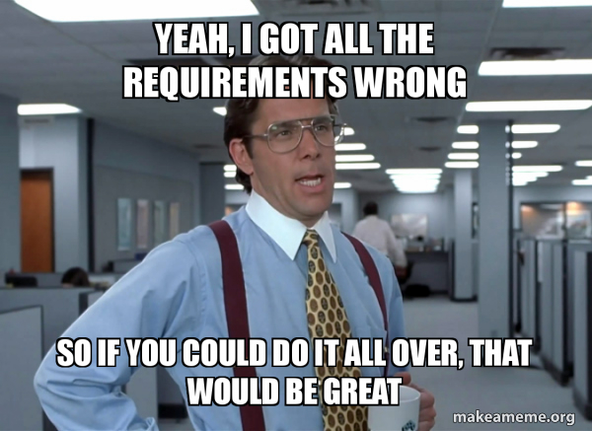
Our RLS adventure today – Requirements change ….. #03
As a Sales VP,
I want to change my sales report,
So that :
The Sales team only see data relevant to them within the hierarchy and the Product Categories and Sales Channels they are responsible for
Non Sales Team members will see all data based on the Product Categories and Sales Channels they are responsible for, but will not be affected by the Sales Team hierarchy
“Others”
“Sales Team”
Sales VP
Sales Director #1
Sales Director #2
Sales Manager #1
Sales Manager #2
Sales Manager #3
Sales Manager #4
Sales Person #1
Sales Person #2
Sales Person #3
Sales Person #4
Sales Person #5
Sales Person #6
Sales Person #7
Sales Person #8
Sales Person …

